Slide 1
Statistics Introduction

Slide 2
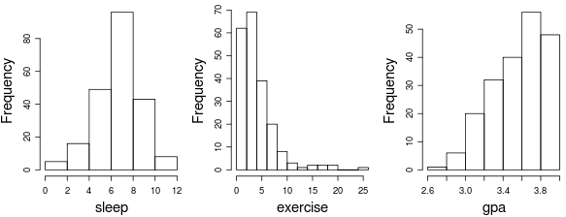

Slide 3
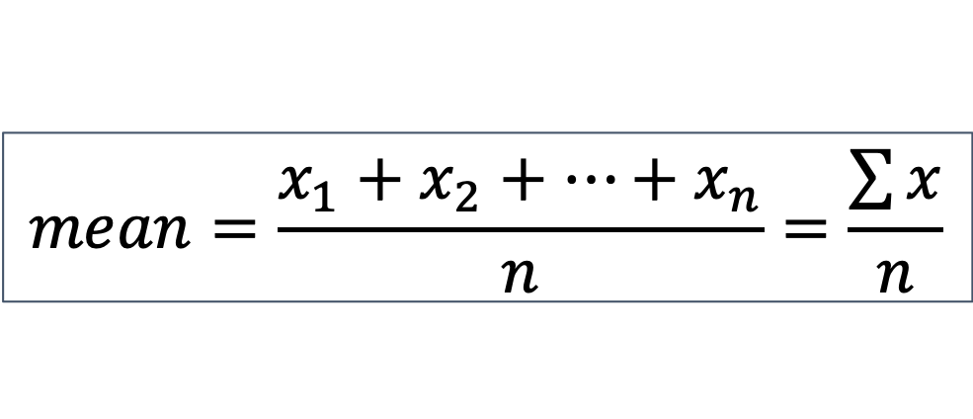
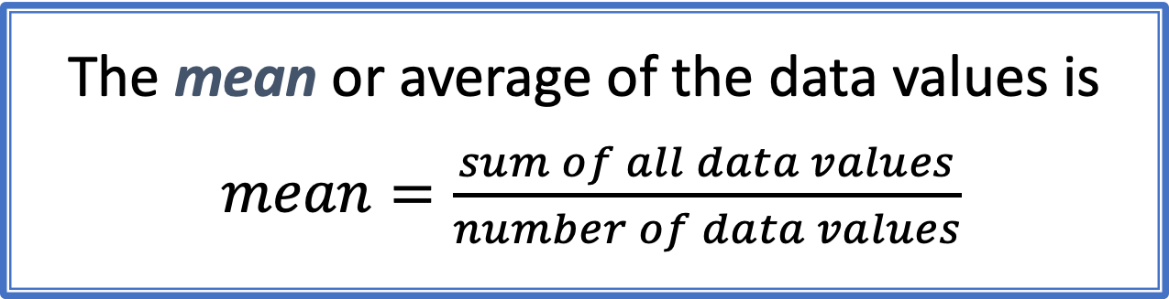
Mean
The mean or average of the data values is
$mean=\frac{sum of all data values}{number of data values}$
$$mean=\frac{x_{1}+x_{2}+…+x_{n}}{n}=\frac{\sum{x}}{n}$$

Slide 4
Median
The median, m, is the middle value when the data are ordered.
If there are an even number of values, the median is the average of the two middle values.
The median splits the data in half.

Slide 5
Mode
The mode is found by collecting and organizing data in order to count the frequency of each result. The result with the highest count of occurrences is the mode of the set,
The mode is the most frequent value.

Slide 6
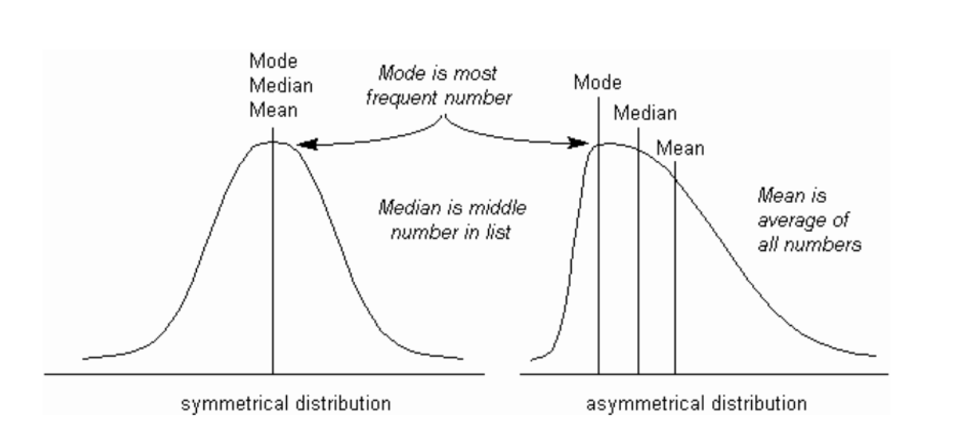

Slide 7
Shape
Long right tail
Symmetric
Right-Skewed
Left-Skewed

Slide 8
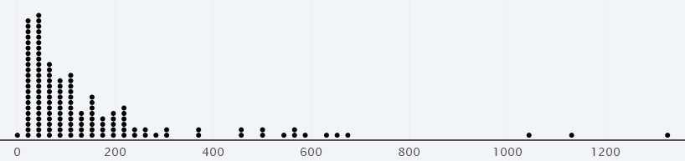
Measures of Center
m = 76.66
Mean is “pulled” in the direction of skewness
μ =150.74
World Gross (in millions)

Slide 9
Skewness and Center
A distribution is left-skewed. Which measure of center would you expect to be higher?
Mean
Median
The mean will be pulled down towards the skewness (towards the long tail).

Slide 10
Outlier
An outlier is an observed value that is notably distinct from the other values in a dataset.

Slide 11
Outliers
Transformers
Harry Potter
Pirates of the Caribbean
World Gross (in millions)

Slide 12
Outliers
When using statistics that are not resistant to outliers, stop and think about whether the outlier is a mistake
If not, you have to decide whether the outlier is part of your population of interest or not
Usually, for outliers that are not a mistake, it’s best to run the analysis twice, once with the outlier(s) and once without, to see how much the outlier(s) are affecting the results

Slide 13
Resistance
A statistic is resistant if it is relatively unaffected by extreme values.
The median is resistant while the mean is not.
 | Mean | Median
With Harry Potter | $150,742,300 | $76,658,500
Without Harry Potter | $141,889,900 | $75,009,000

Slide 14
Other Measures of Location
Maximum = largest data value
Minimum = smallest data value
Quartiles:
Q₁ = median of the values below m.
Q₃ = median of the values above m.

Slide 15
Five Number Summary
Five Number Summary:
Min
Q₁
m
Q₃
Max
←25%→
←25%→
←25%→
←25%→
R: summary(x)

Slide 16

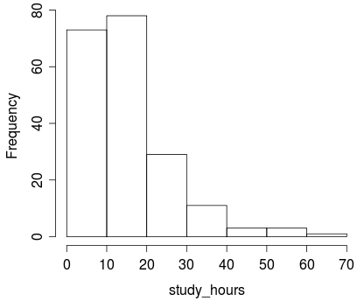
Five Number Summary
> summary(study_hours)
Min. 1st Qu. Median 3rd Qu. Max.
2.00 10.00 15.00 20.00 69.00
The distribution of number of hours spent studying each week is
Symmetric
Right-skewed
Left-skewed
Impossible to tell

Slide 17
Five Number Summary
Five Number Summary:
Min
Q₁
m
Q₃
Max
←25%→
←25%→
←25%→
←25%→
0th percentile
25th percentile
50th percentile
75th percentile
100th percentile

Slide 18
Outliers
Outliers can be informally identified by looking at a plot, but one rule of thumb for identifying outliers is data values more than 1.5 IQRs beyond the quartiles
Interquartile Range (IQR) = Q₃ – Q₁
A data value is an outlier if it is
Smaller than Q₁ – 1.5(IQR)
or
Larger than Q₃ + 1.5(IQR)

Slide 19
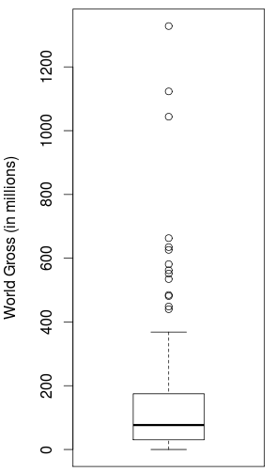
Boxplot
Outliers
Lines (“whiskers”) extend from each quartile to the most extreme value that is not an outlier
Q₃
Median
Q₁

Slide 20
Boxplot
Which boxplot goes with the histogram of waiting times for the bus?
(a)
(b)
(c)
The data do not show any low outliers.

Slide 21
Measures of Spread
Range = Max – Min
Interquartile Range (IQR) = Q₃ – Q₁
Is the range resistant to outliers?
Yes
No
Is the IQR resistant to outliers?
Yes
No
The range depends entirely on the most extreme values.
The IQR is based off the middle 50% of the data, which will not contain outliers.

Slide 22
Standard Deviation
The standard deviation gives a rough estimate of the typical distance of a data values from the mean
The larger the standard deviation, the more variability there is in the data and the more spread out the data are

Slide 23
Standard Deviation
Both of these distributions are bell-shaped

Slide 24
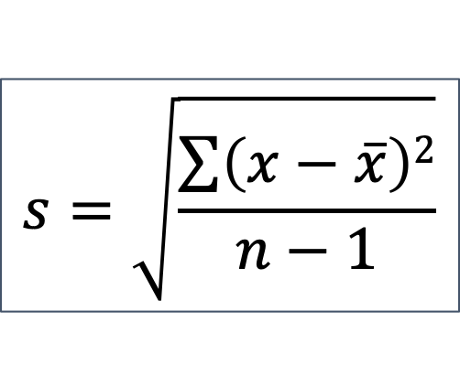
Standard Deviation
The standard deviation for a quantitative variable measures the spread of the data
$$s=\sqrt{\frac{\sum{\left(x−\overline{x}\right)2}}{n−1}}$$
Sample standard deviation: s

Slide 25

z-score
A z-score puts values on a common scale
A z-score is the number of standard deviations a value falls from the mean
95% of all z-scores fall between what two values?
z-scores beyond -2 or 2 can be considered extreme
-2 and 2

Slide 26
Statistical Inference
Statistical inference is the process of drawing conclusions about the entire population based on information in a sample.

Slide 27
Margin of Error
One common form for an interval estimate is
statistic ± margin of error
where the margin of error reflects the precision of the sample statistic as a point estimate for the parameter.

Slide 28
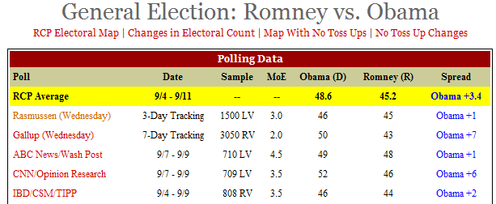
Election Polling
Why is the margin of error smaller for the Gallup poll than the ABC news poll?
http://www.realclearpolitics.com/epolls/2012/president/us/general_election_romney_vs_obama-1171.html

Slide 29
Population Dataset vs. Sample Dataset
Population Dataset
Sample Dataset
Dataset containing all possible elements of an experiment or study.
In statistics, “population” does not mean “people.”
Any complete set of data is a population dataset.
A subset of population data.
A sample dataset can be selected randomly from the population or selected with bias.
Notes:
In statistics, a population is a complete dataset that contains all possible elements of a study or experiment. In this scenario, the population dataset would be the voting habits of all eligible voters in the city.
In statistics, a sample is a subset of a population dataset, where not all elements of a study or experiment are collected or measured. In this scenario, the sample dataset is the 1,000 eligible voters polled across the city.
In data science, the concept of sample versus population does not strictly apply to people and/or animals. Any comprehensive dataset is considered a population, and any dataset that is a subset of a larger data set is considered a sample.

Slide 30
Sample Size
As the sample size increases, the variability of the sample statistics tends to decrease and the sample statistics tend to be closer to the true value of the population parameter
For larger sample sizes, you get less variability in the statistics, so less uncertainty in your estimates

Slide 31
Standard Error (SE or SEM)
The standard error of a statistic, SE, is the standard deviation of the sample statistic
The standard error measures how much the statistic varies from sample to sample
The standard error can be calculated as the standard deviation of the sampling distribution

Slide 32
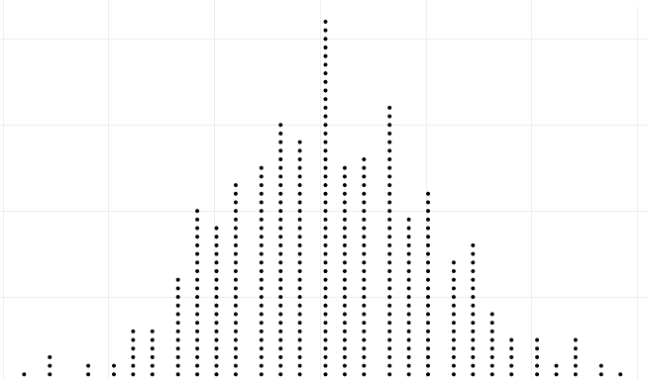
Confidence Intervals
Confidence Interval
statistic ± ME
Population
Sample
Sample
. . .
Sample
Sample
Margin of Error (ME)
(95% CI: ME = 2×SE)
Sample
Sample
Sampling Distribution
Calculate statistic for each sample
Standard Error (SE): standard deviation of sampling distribution

Slide 33
Correlation describes the question,“Is there a relationship between A and B?”
Notes:
Often in data analysis we will ask the question “Is there a relationship between Factor A and Factor B?" This concept is known in statistics as correlation.

Slide 34
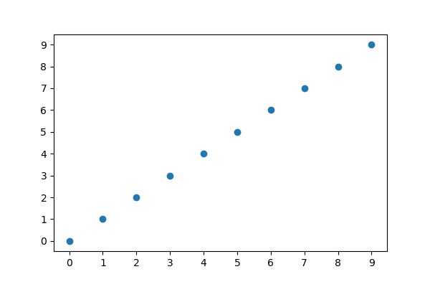
Positive Correlation
Notes:
This is an example of a positive correlation. When two factors are positively correlated, they move in the same direction. When the factor on the x-axis increases, the factor on the y-axis increases as well.

Slide 35
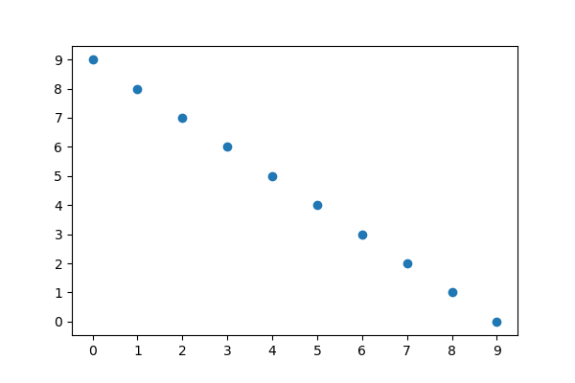
Negative Correlation
Notes:
This is an example of a negative correlation. When two factors are negatively correlated, they move in opposite directions. When the factor on the x-axis increases, the factor on the y-axis decreases.

Slide 36
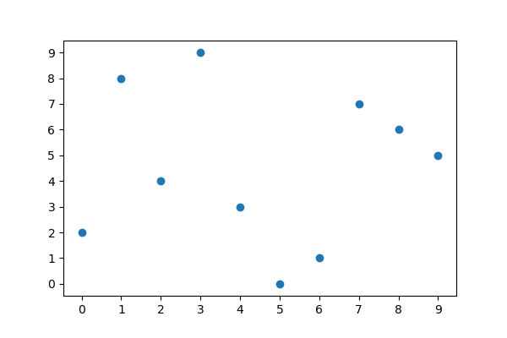
No Correlation
Notes:
This is an example of two factors with no correlation. When two factors are not correlated, their values are completely independent between one another.
With real-world data, it can be difficult to determine if two factors are correlated. Therefore, we must be able to quantify the correlation between two factors.

Slide 37
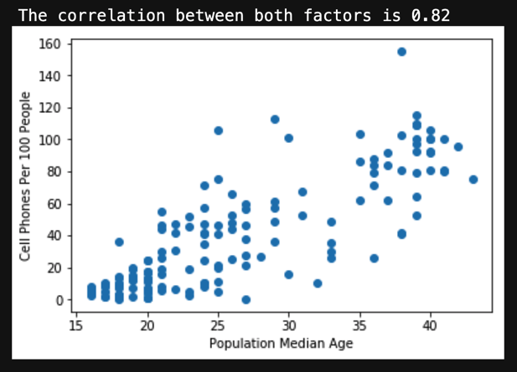
Pearson’s Correlation Coefficient
In statistics, we quantify correlation using Pearson’s r.
Pearson’s correlation coefficient describes the variability between two factors, denoted by the variable r.
Pearson’s r is –1 ≤ r ≤ 1
–1 indicates perfect negative correlation.
1 indicates perfect positive correlation.
0 indicates no correlation.
Real-world data is never perfect.
Notes:
In statistics, we can calculate the degree of correlation using the Pearson correlation coefficient.
The Pearson correlation coefficient is a quantitative measure that describes simultaneous movement (variability) of two factors.
The correlation coefficient (which is often indicated with the letter r) will always fall between –1 and 1.
An r-value of 1 indicates a perfect positive correlation, while an r-value of –1 indicates a perfect negative correlation.
An r-value of 0 means that there is no relationship between the two factors. Most of the time real-world data will not be the ideal case of –1,0, or 1. However, we can look at the correlation coefficient to determine how strong or weak two factors are related.

Slide 38

Q
What is the equation of a line?
Notes:
Ask the students if anyone remembers the equation of a line.

Slide 39
The equation of a line is:
y = mx + b
Notes:
Most people were taught in school the equation of a line is y = mx + b.

Slide 40
The Equation of a Line
y = mx + b
Slope
y-intercept
Dependent variable
Independent variable
Notes:
The equation of a line defines the relationship between x-values and y-values.
When it comes to variables in the equation, we refer to the `x` in the equation as the independent variable variable, and the `y` as the dependent variable.
Additionally, the slope of a line is denoted as `m` in the equation and the y-intercept is denoted as `b` in the equation.
Knowing the slope and y-intercept of a line, we can determine any value of `y` given the value for `x`. This is why we say `y` is dependent on `x`.

Slide 41
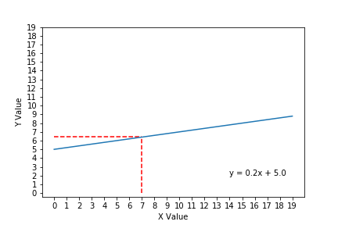
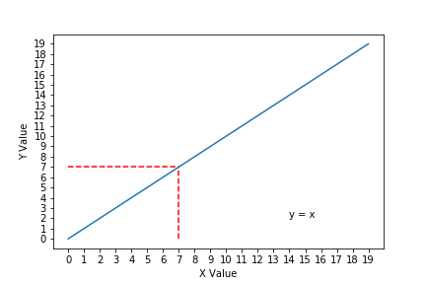
The equation of a line determines y values given x
In this example:
Slope = 1
y-intercept = 0
Whatever x is, the value of y is the same.
Notes:
This first plot is considered the ideal linear relationship of y and x, where the x and y values are the same value.
In this plot, the equation for line is y = x because the slope is equal to 1 and the y-intercept is equal to 0.
If we look at the x-value of 7 (denoted by the vertical dashed line), the corresponding y-value is also 7 (denoted by the horizontal dashed line).

Slide 42
The Equation of a Line Determines y Values, Given x
In this example:
Slope = 0.2
y-intercept = +5
If x = 7, then y = 6.4
Notes:
In this linear relationship between x and y, the slope is much smaller, but the y-intercept is much larger.
If you plug an x-value of 7 into the equation, the resulting y-value is 6.4. Demonstrate this to the class.
This idea of relating x-values and y-values using the equation of a line is the general concept of linear regression.

Slide 43
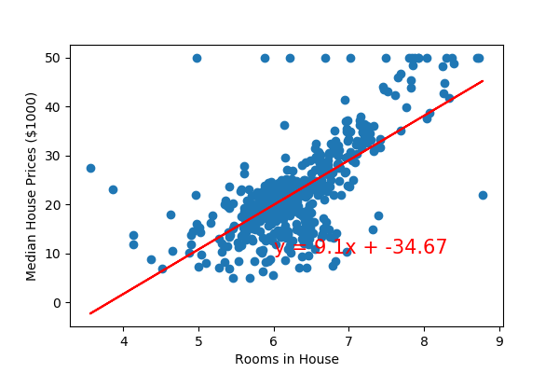
Linear Regression Fits the Equation of a Line to Real-World Data
Linear regression…
Predicts the values of factor B, given values from factor A.
Estimates where data points that were not measured might end up if more data was collected.
Is used to predict housing prices, stock market, weather, etc.
Notes:
Linear regression is used in data science to model and predict the relationship between two factors.
Although this may sound similar to correlation, there is a big difference between the two concepts: correlation quantifies if Factor Y and Factor X are related, while regression predicts Factor Y values given values from Factor X.
By fitting the relationship of two factors to a linear equation, linear regression allows us to predict where data points we did not measure might end up if we had collected more data.
Linear regression is a truly powerful tool; it provides us the means to predict house prices, stock market movements, and the weather based on other data.
We will not dive into the mathematical details of linear regression—rather, we will focus on how to use SciPy's linregress function to perform a linear regression, and visualize the linear regression using Matplotlib.

